Slide 1
TOOLS

Slide 2
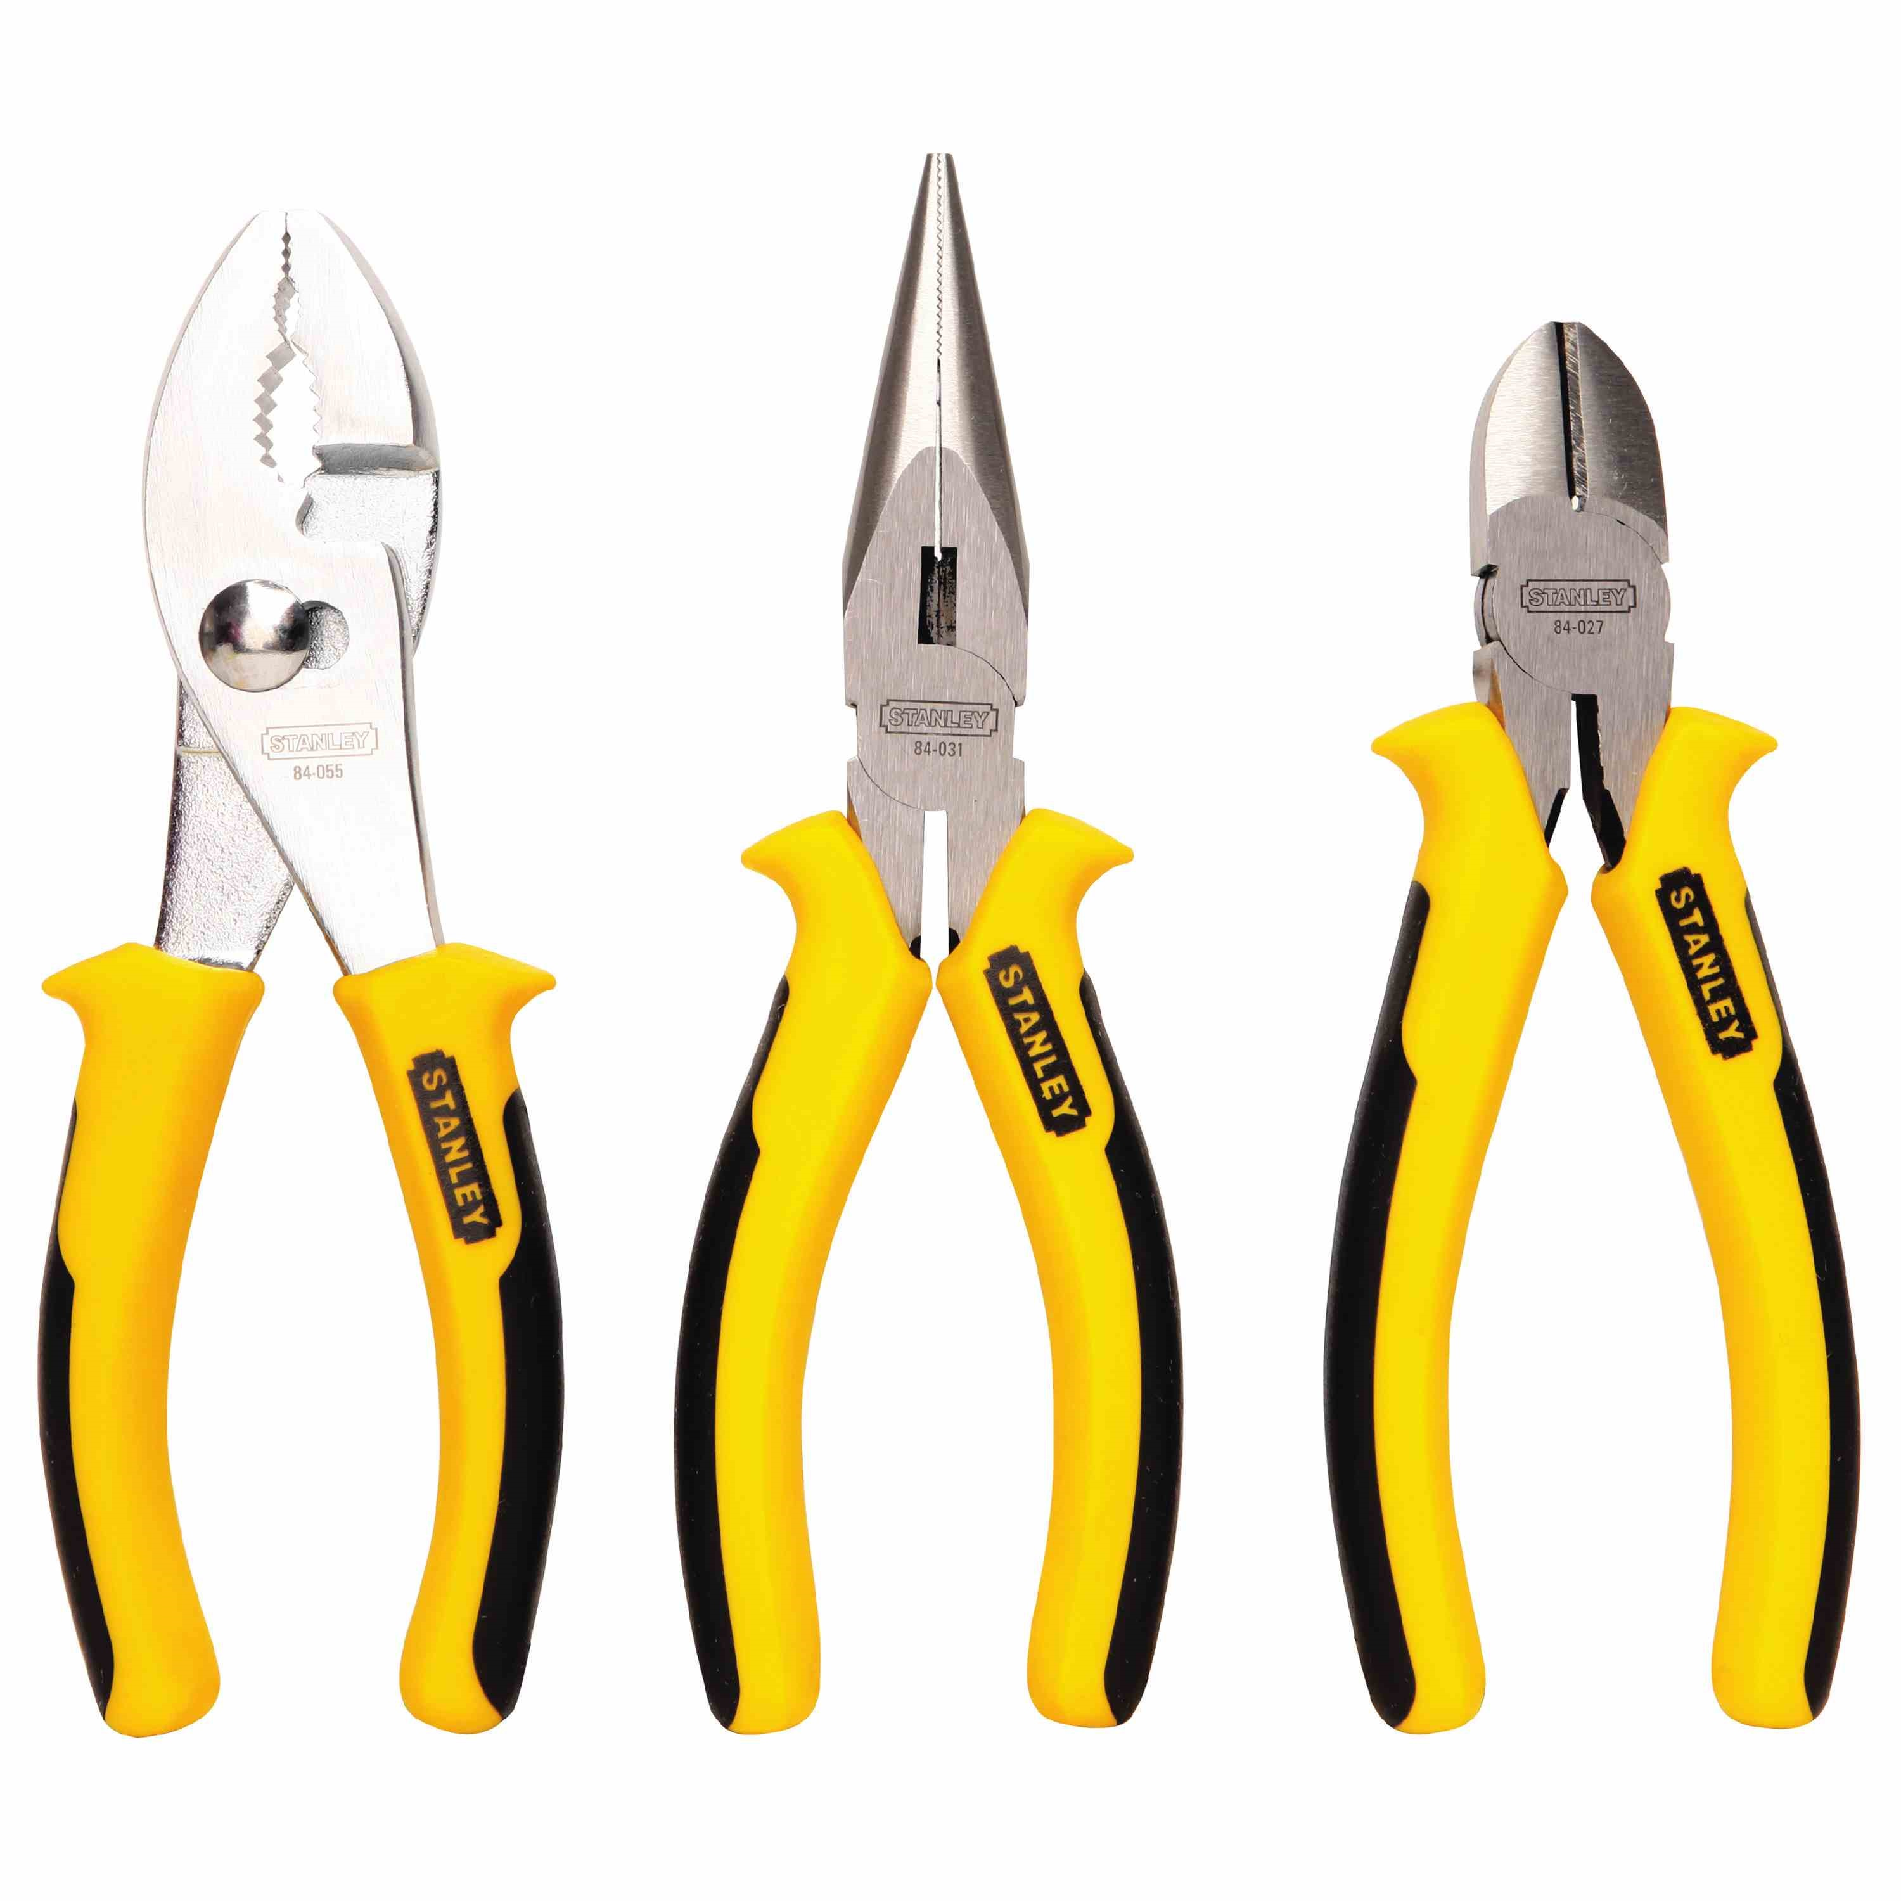
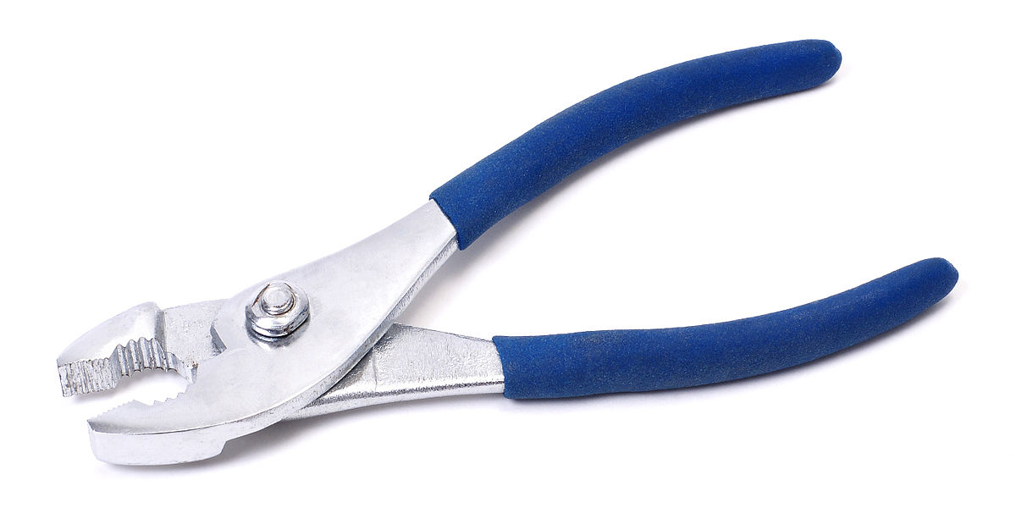
Pliers

Slide 3
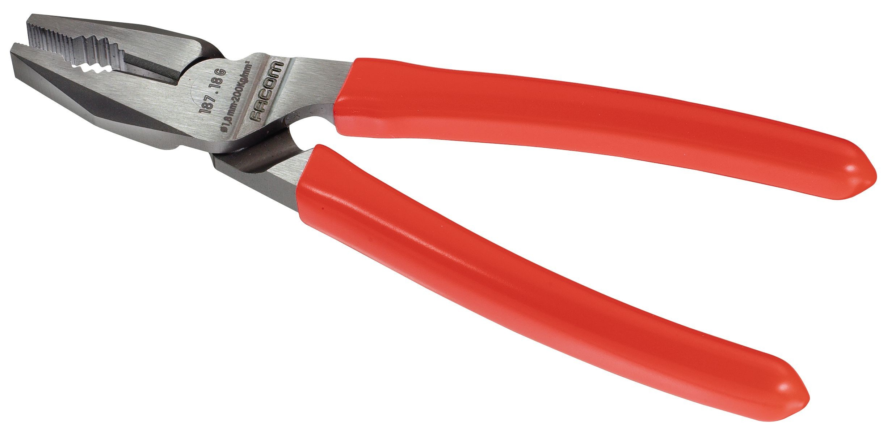
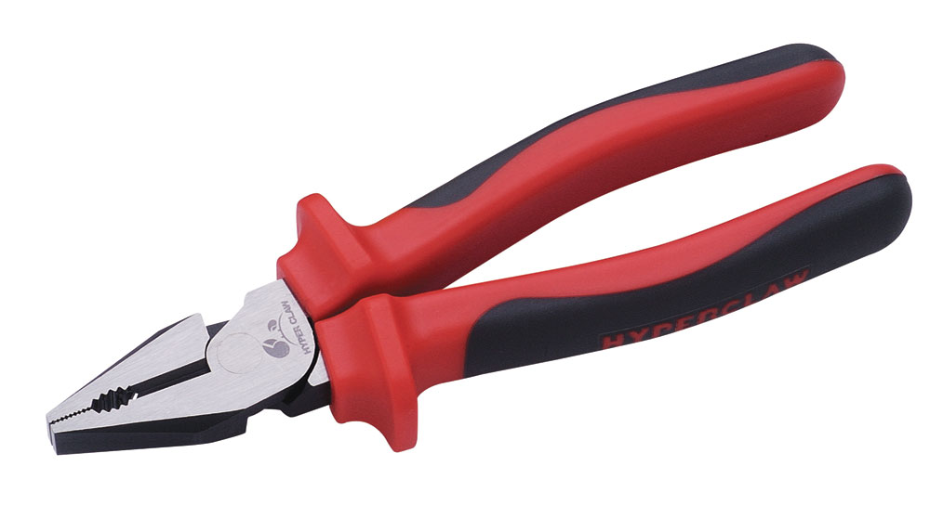
Combination Pliers (Kìm đa năng)

Slide 4
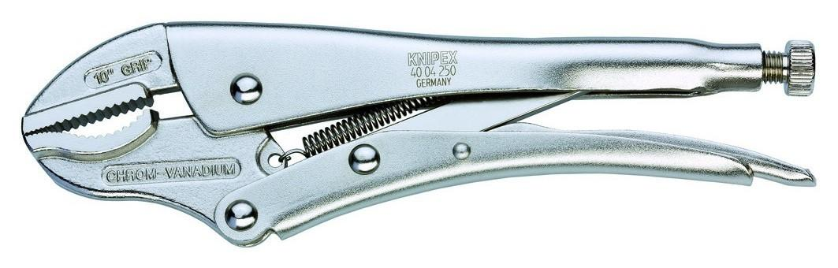
Locking Pliers (Kìm khóa hay kìm cộng lực)

Slide 5
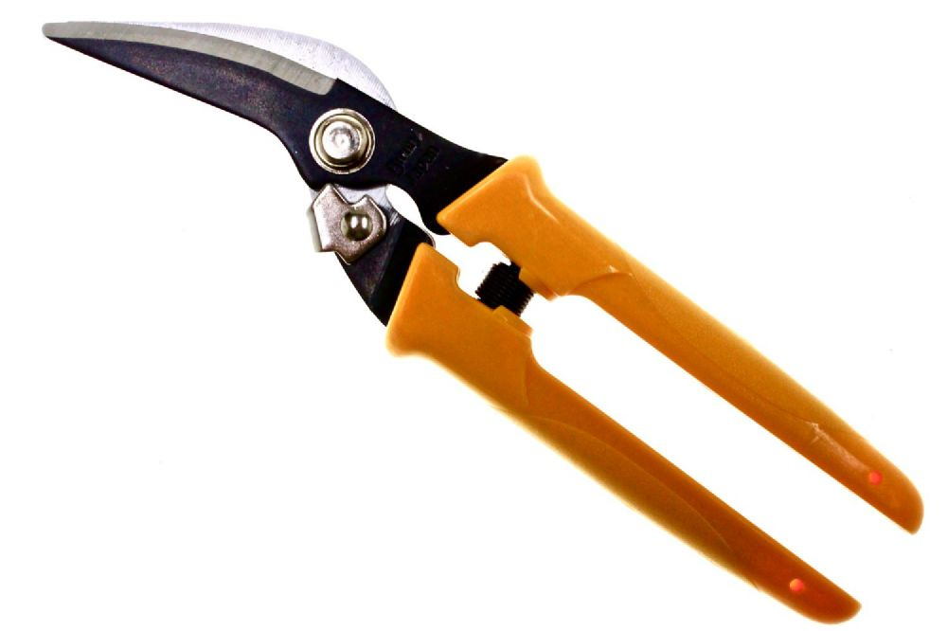
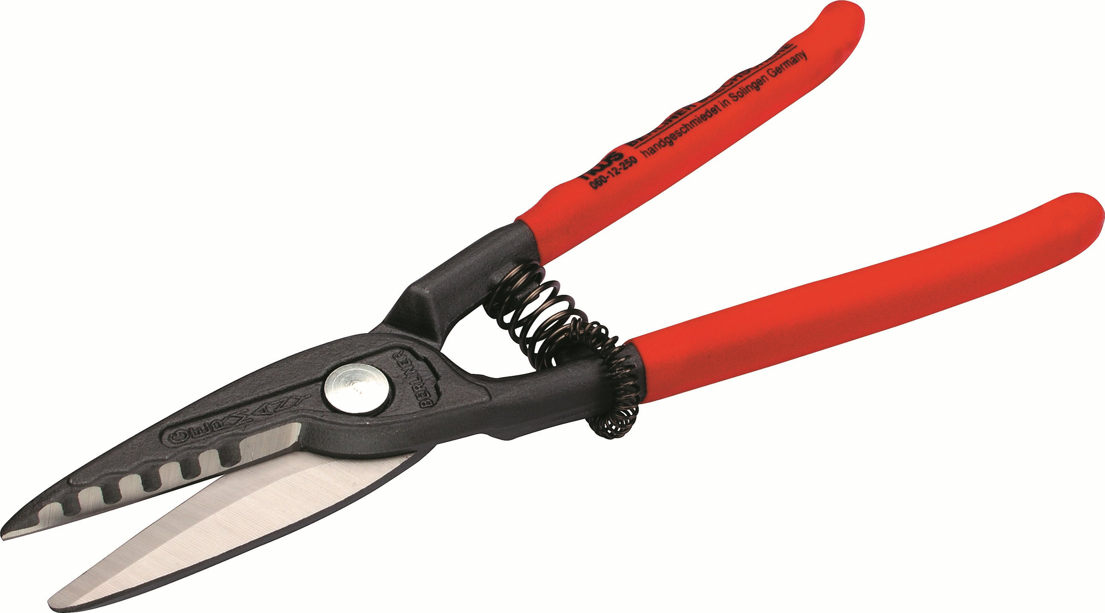
Tin Snips

Slide 6
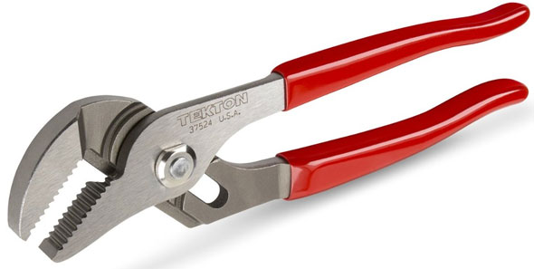
Adjustable Joint Pliers

Slide 7
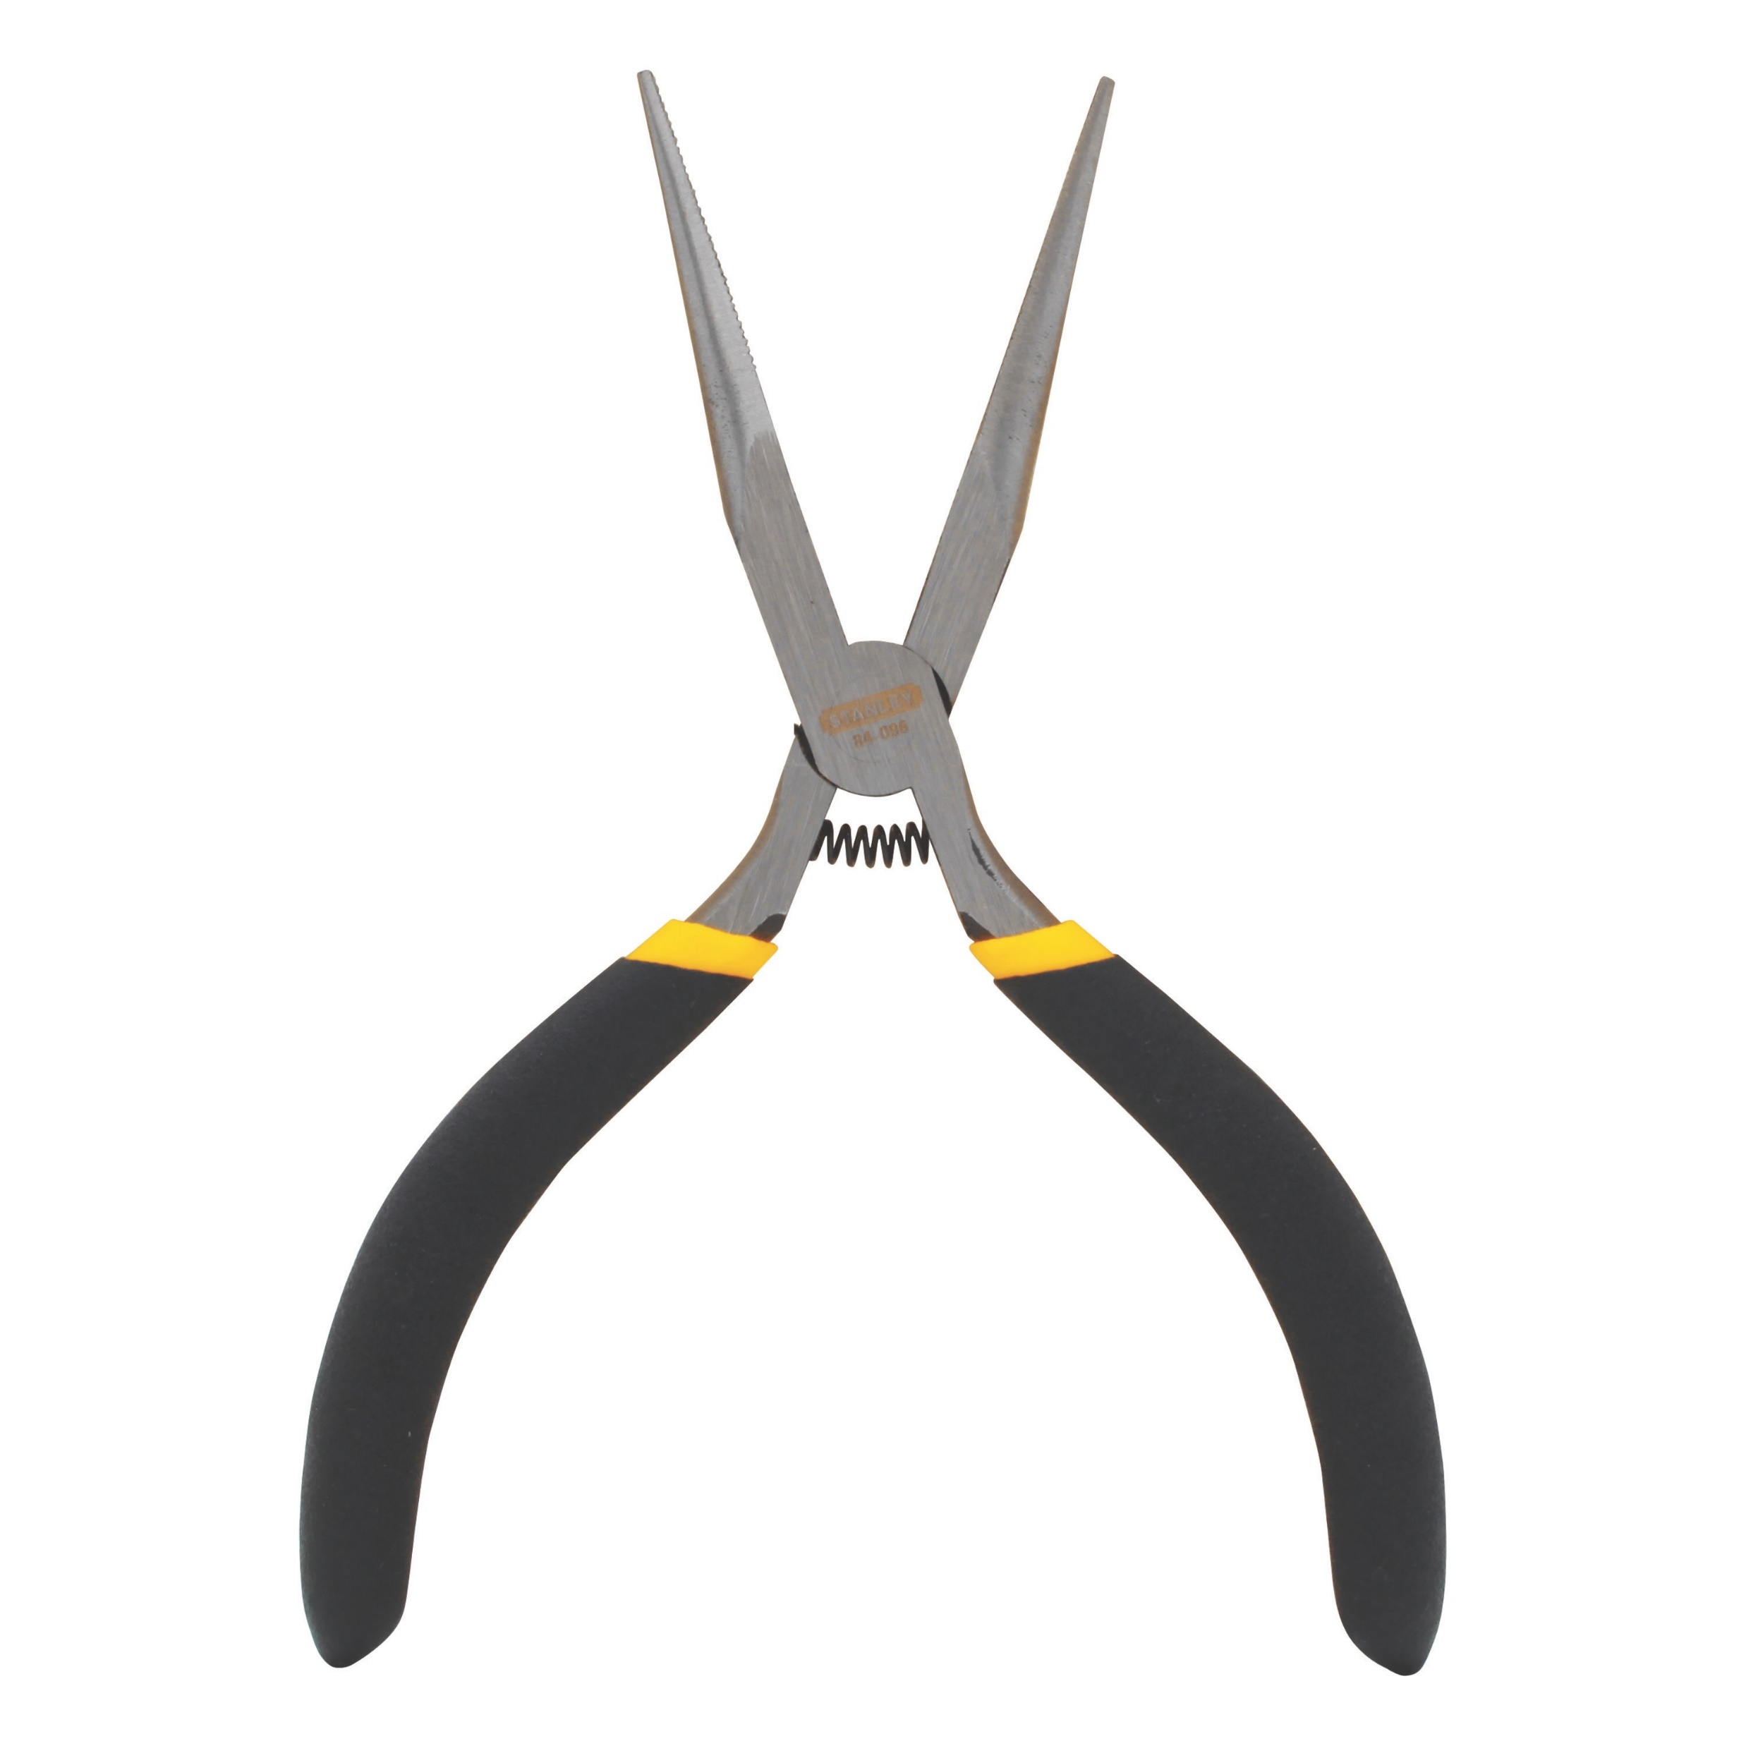
Needle Nose Pliers (Kìm đầu nhọn)

Slide 8
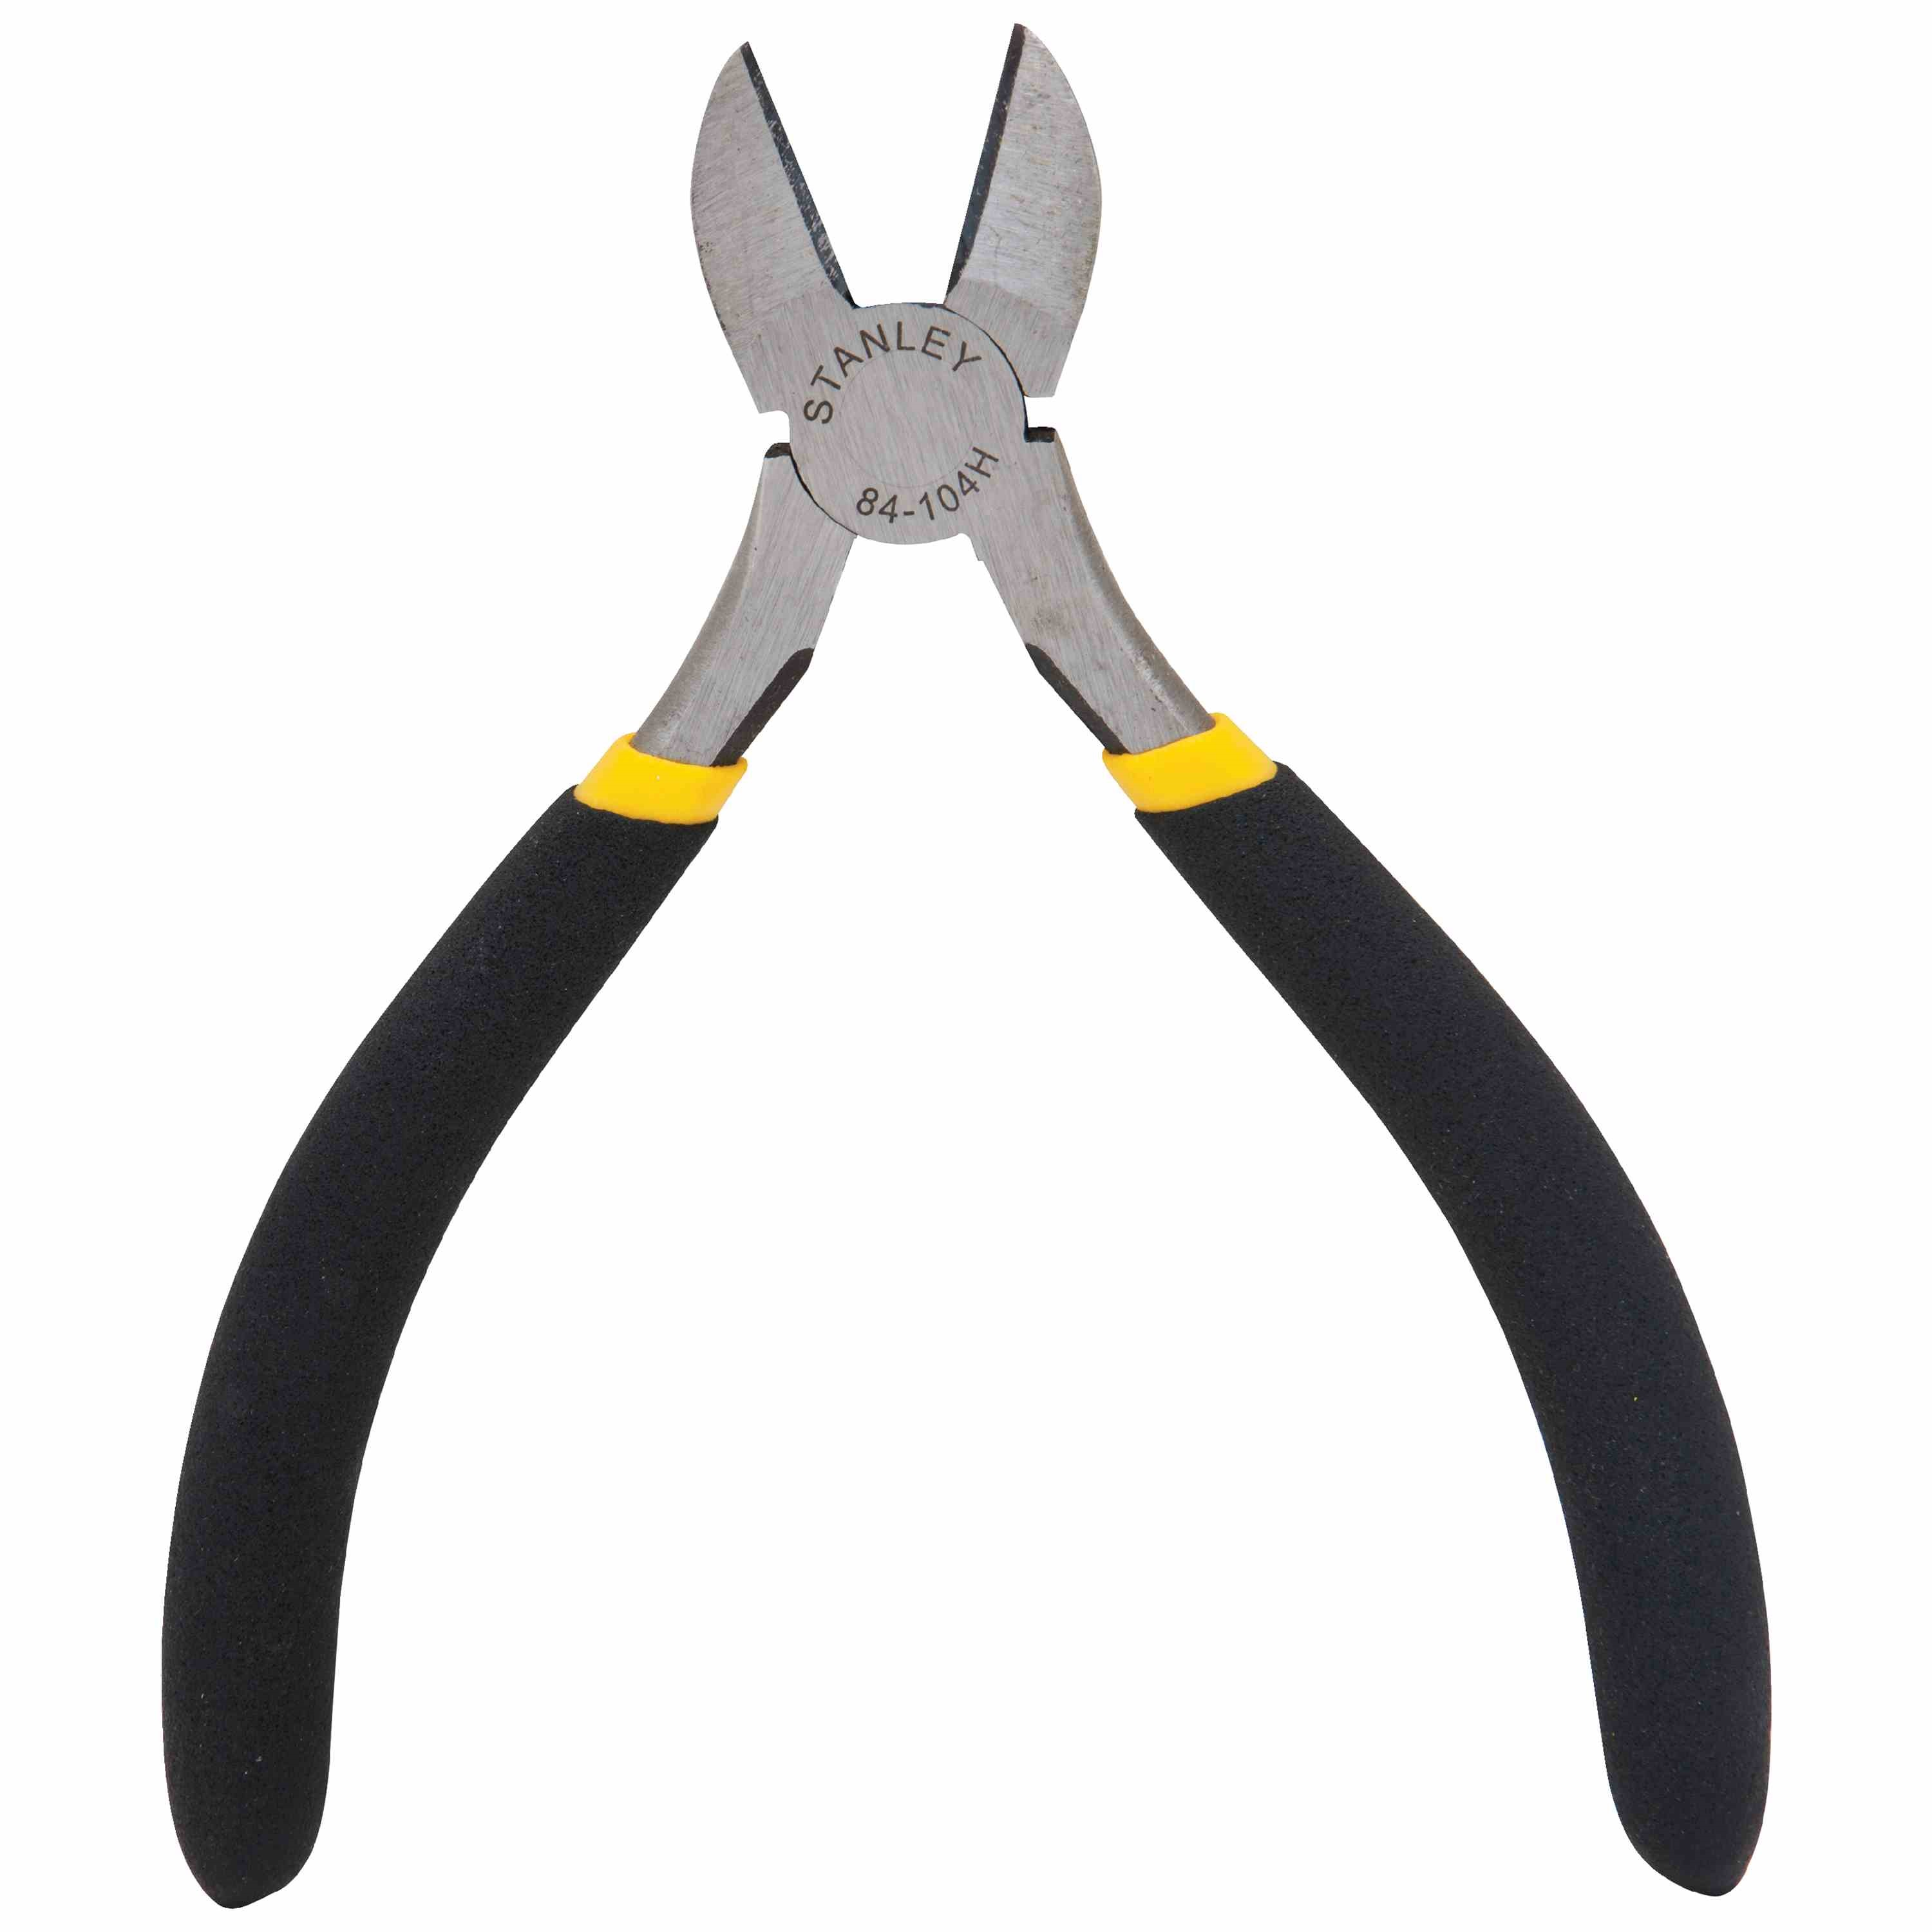
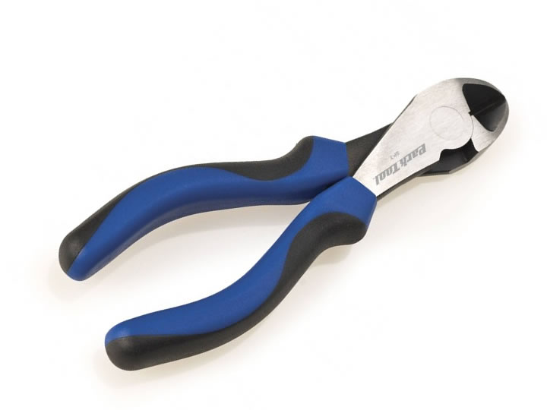
Diagonal pliers/Diagonal cutter/Cutter pliers

Slide 9
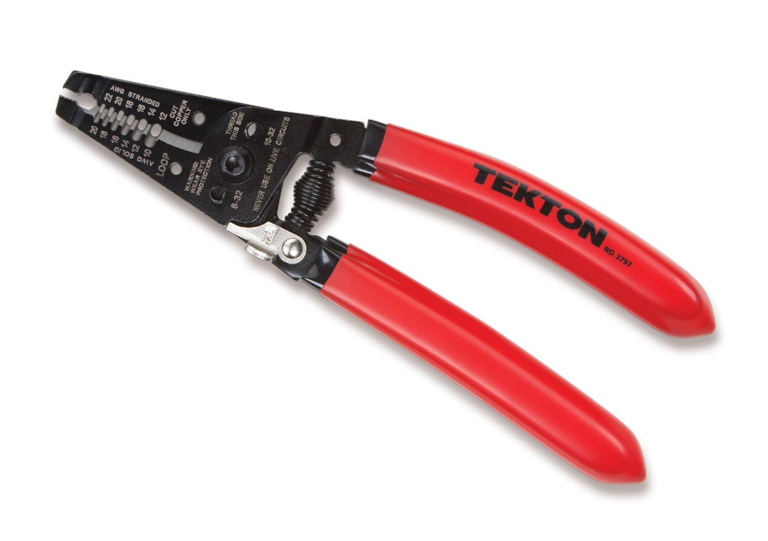
Wire Strippers/Wire Crimpers (Kìm tuốt dây)

Slide 10
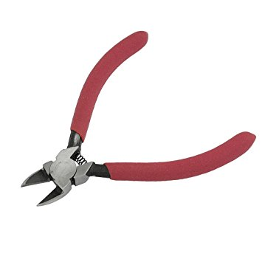
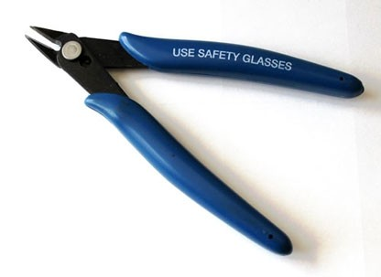
wire snips (Kìm bấm dây)

Slide 11
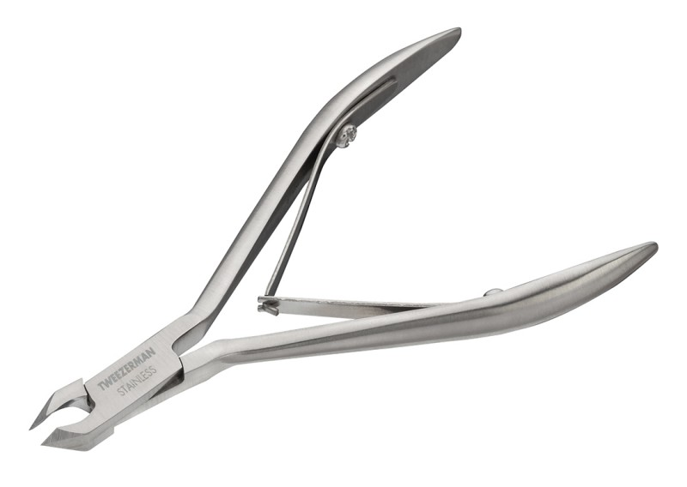
Nipper

Slide 12
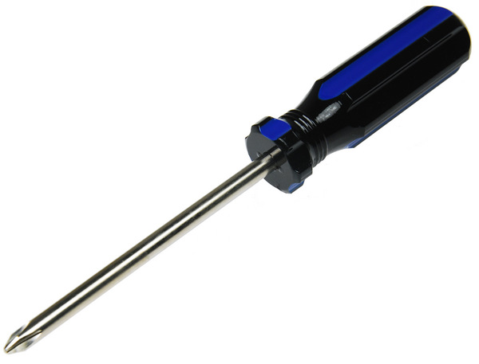
Phillips Head Screwdriver (4 cạnh)

Slide 13
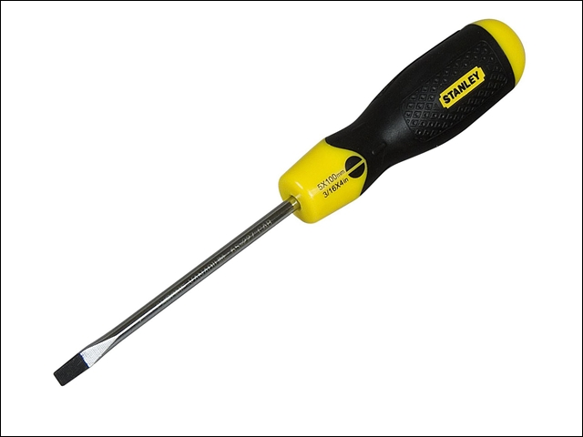
Screwdriver – Paralle/Slotted screwdriver/flat head screwdriver

Slide 14
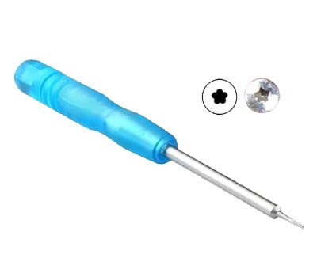
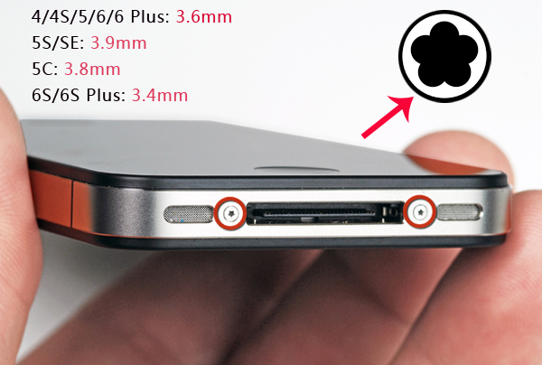

pentalobe screwdriver

Slide 15
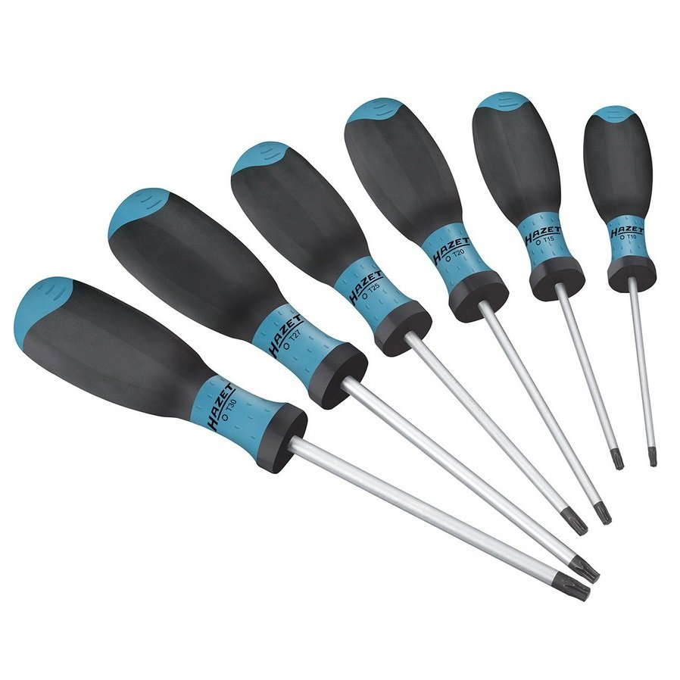
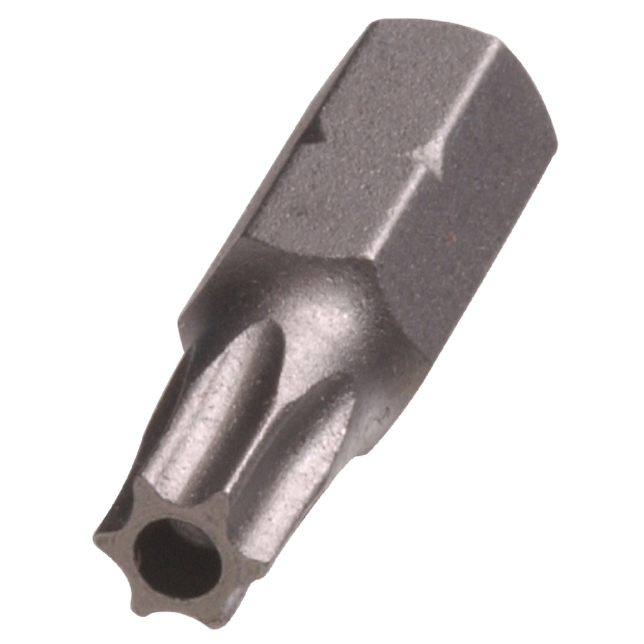
torx screwdriver

Slide 16
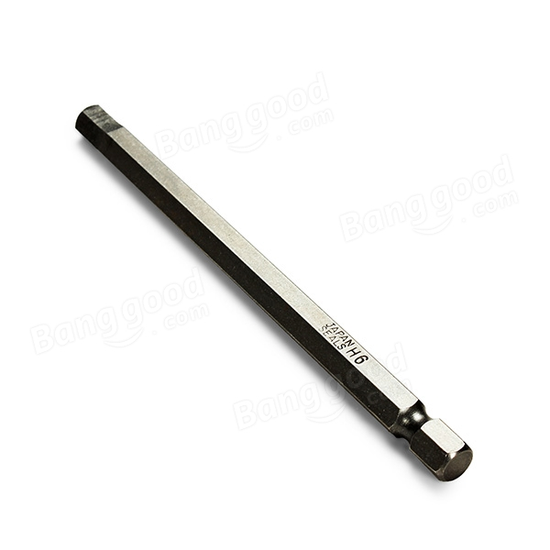
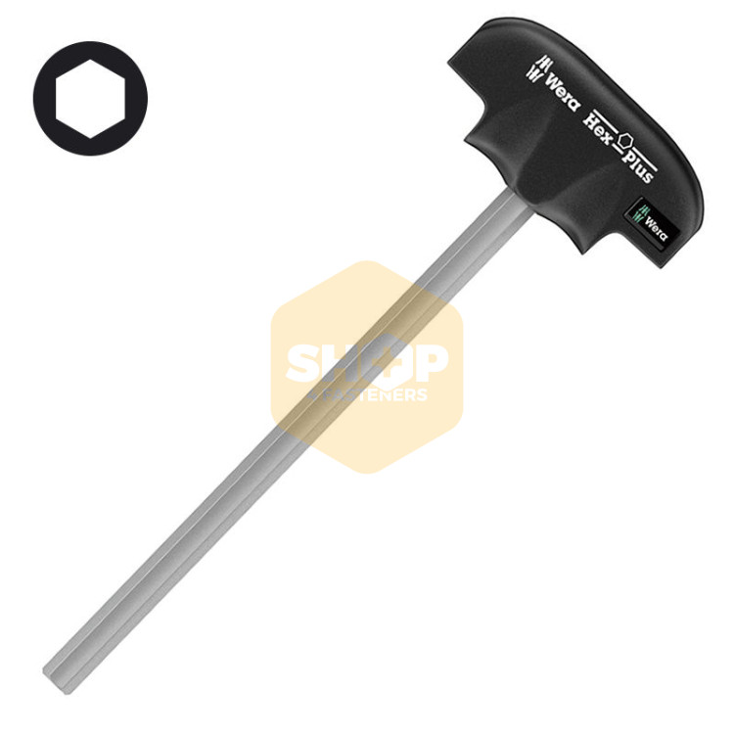
Hexagon screwdriver

Slide 17
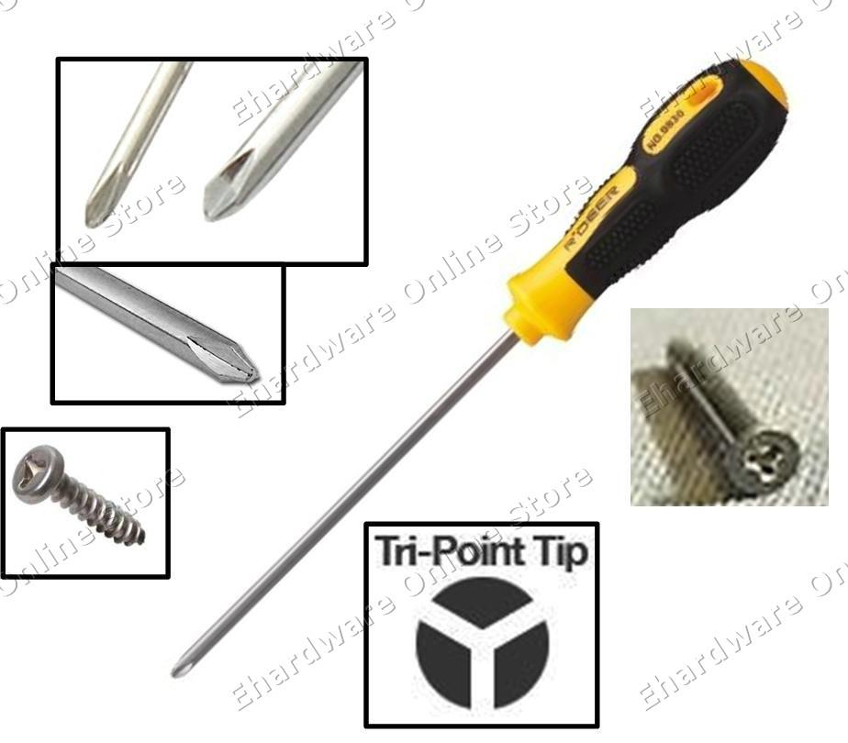
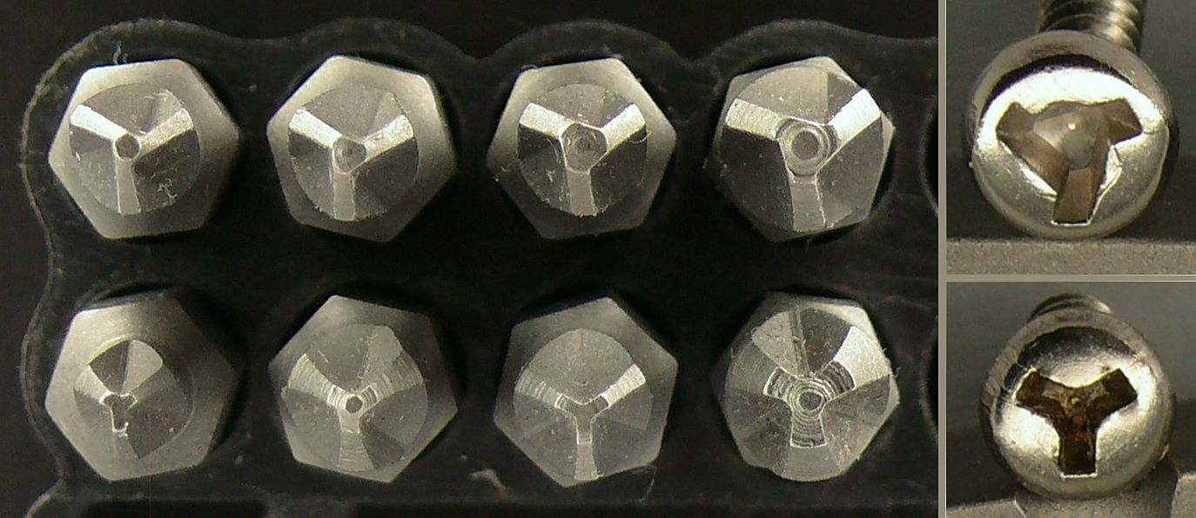
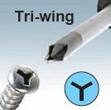
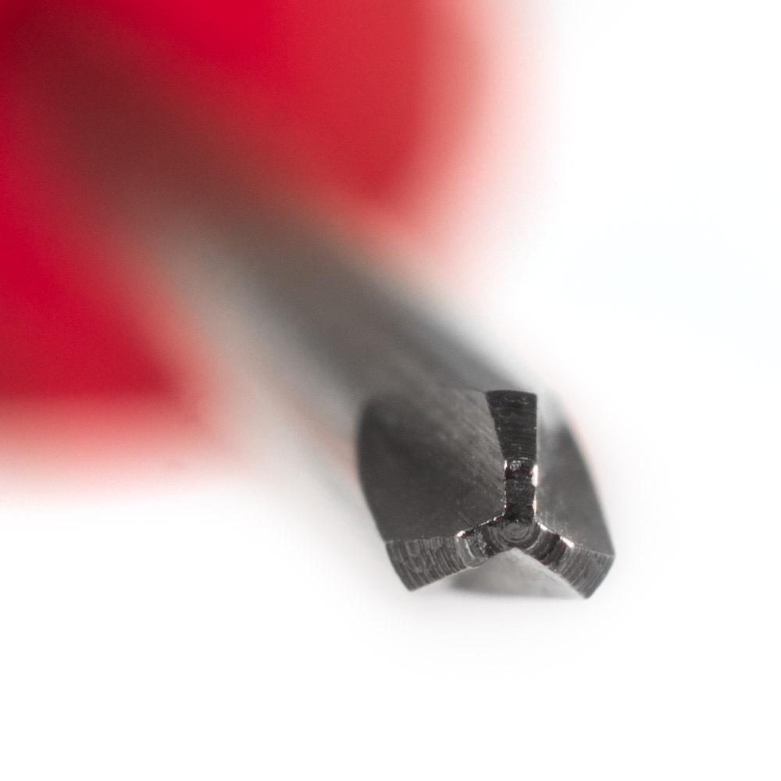
tri wing screwdriver

Slide 18
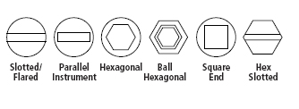
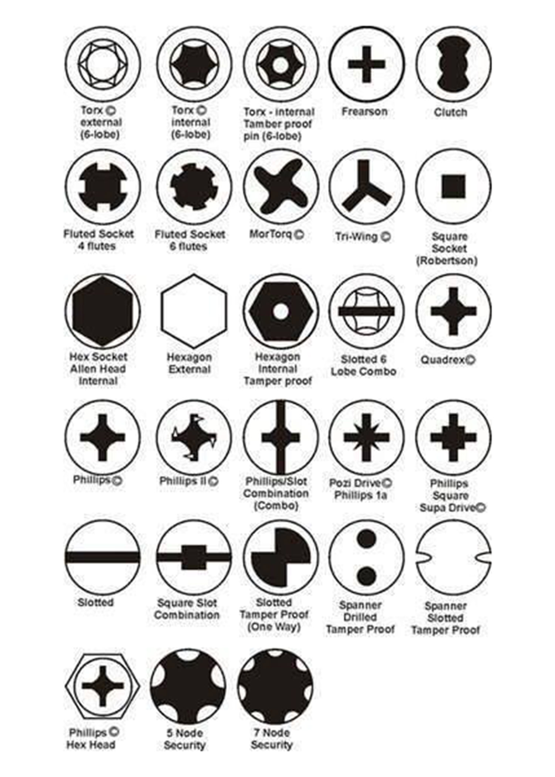
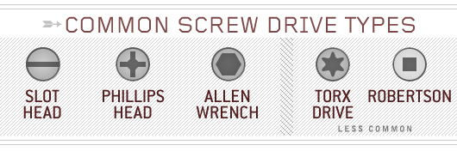
type of screws heads

Slide 19
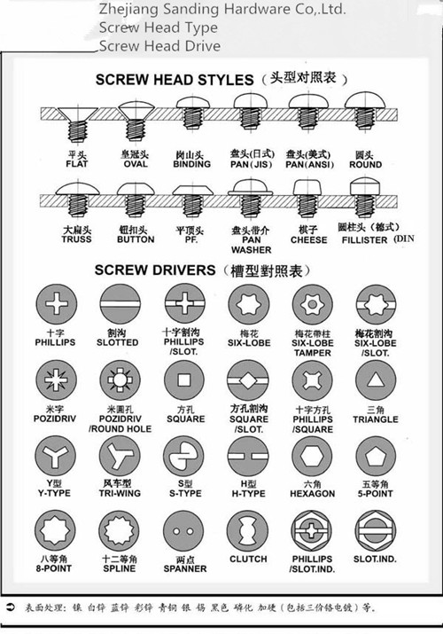
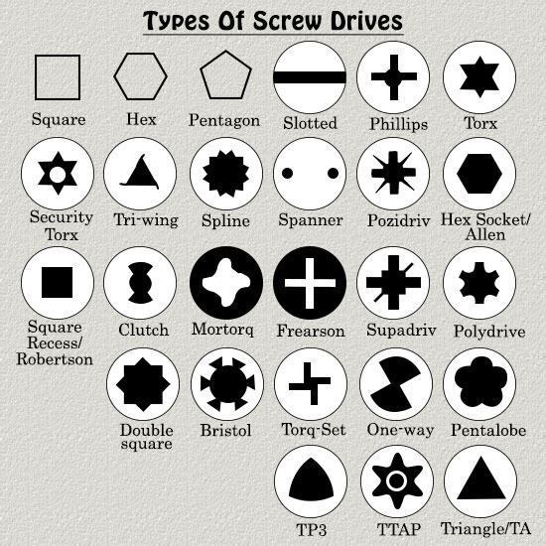
type of screws heads

Slide 20
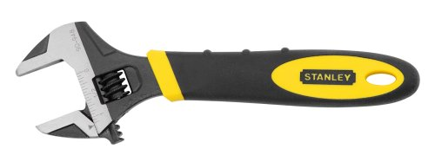
Wrench (Mỏ Lết)

Slide 21
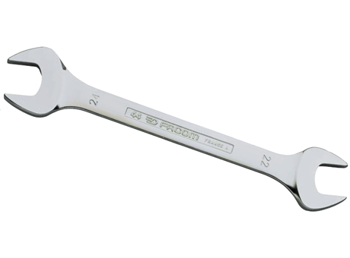
open end wrenches (Cờ lê 2 đầu)

Slide 22
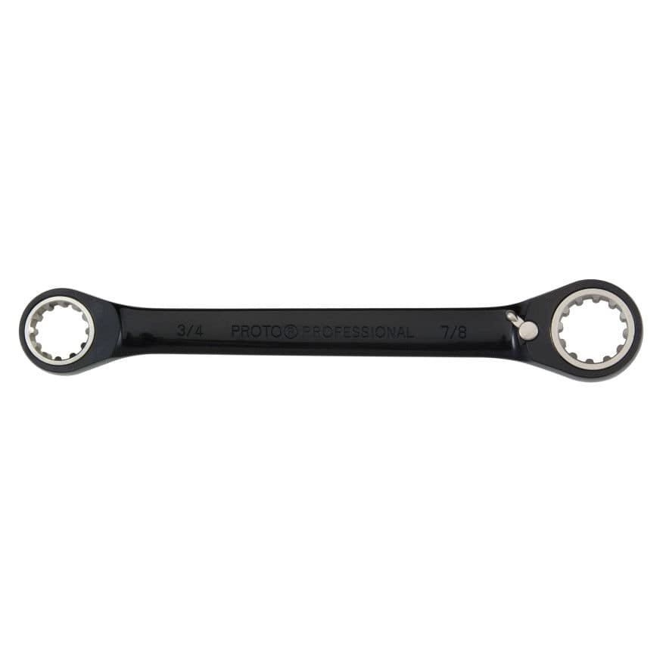
Spline End Wrenches (Cờ lê vành đóng)

Slide 23
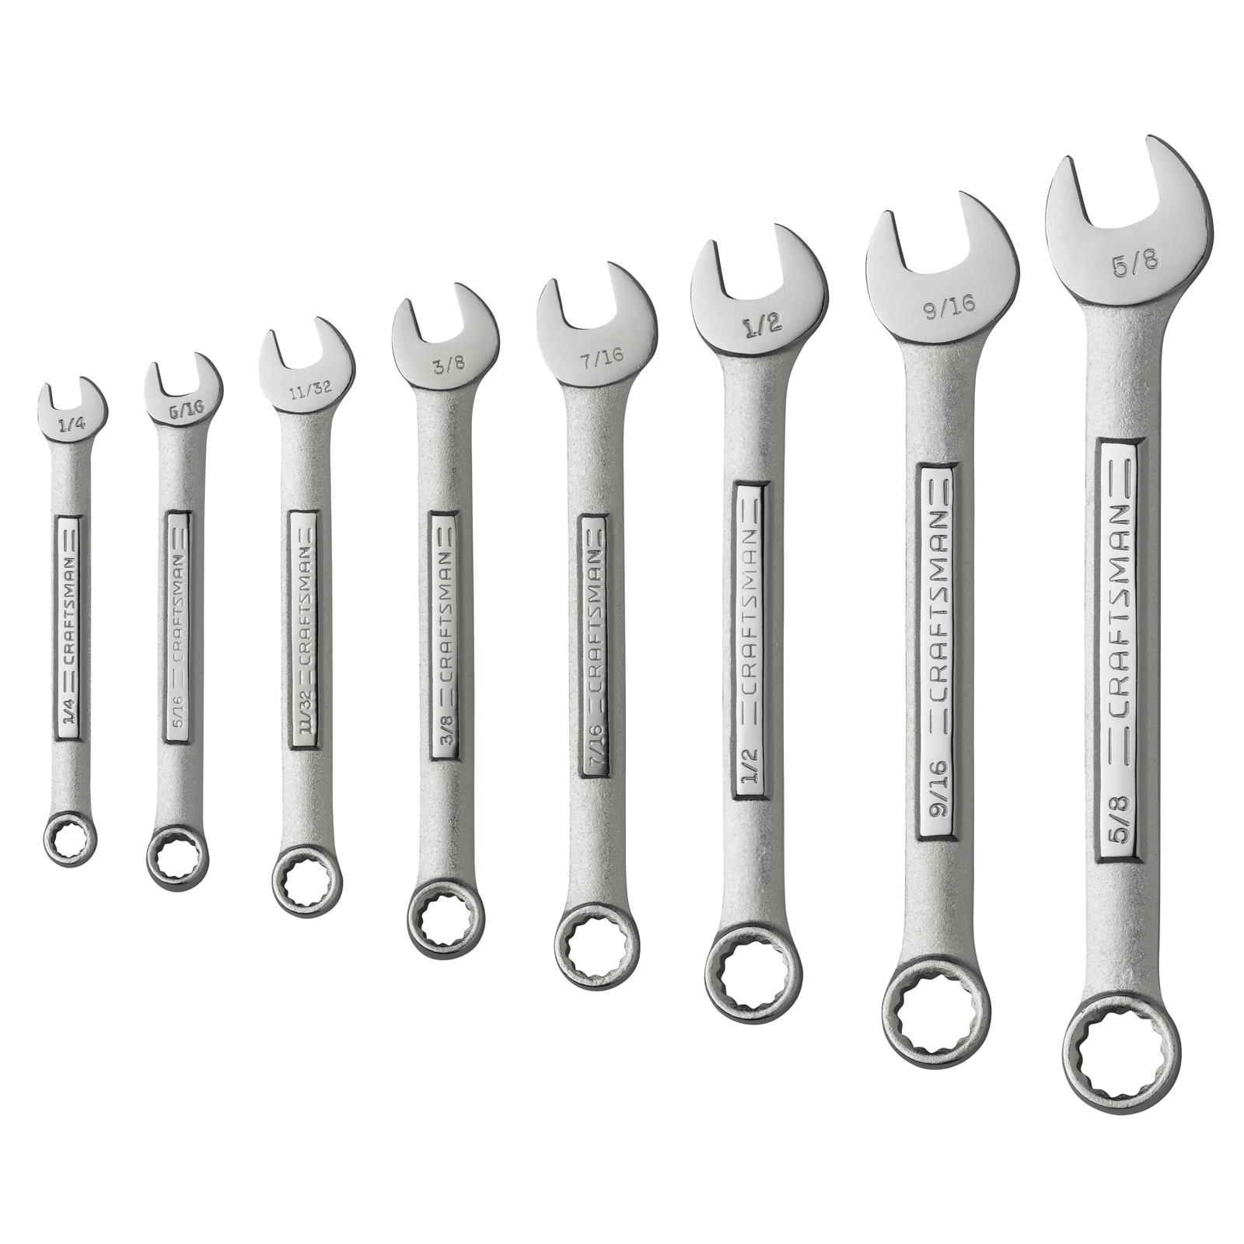
Ratchet Wrenches or Combination Wrenches (Cờ lê 1 đầu mở 1 đầu đóng)

Slide 24
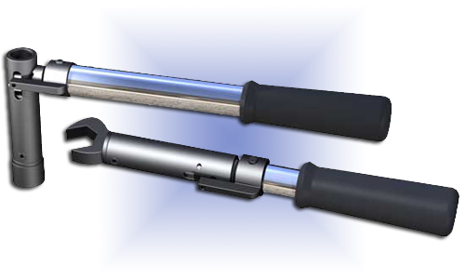
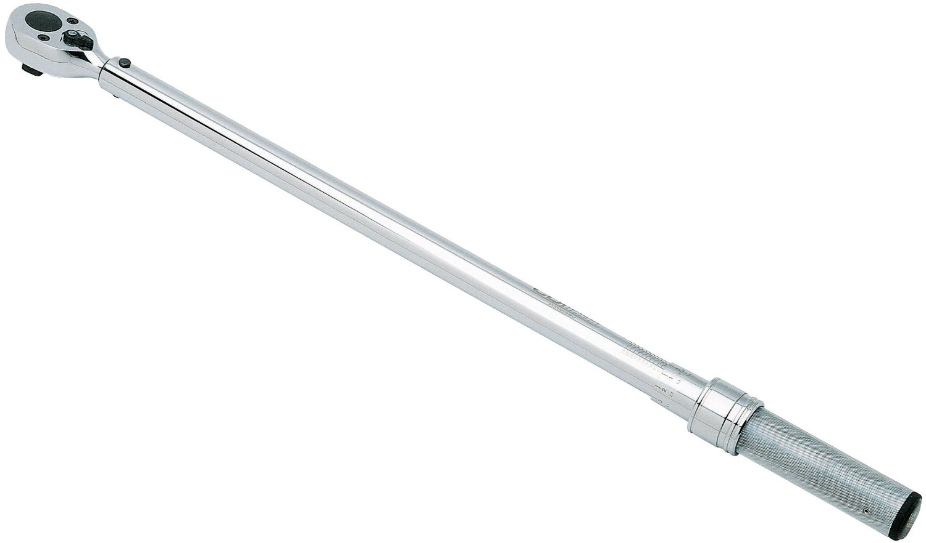
Torque Wrenches (Cờ lê và cần xiết lực)

Slide 25
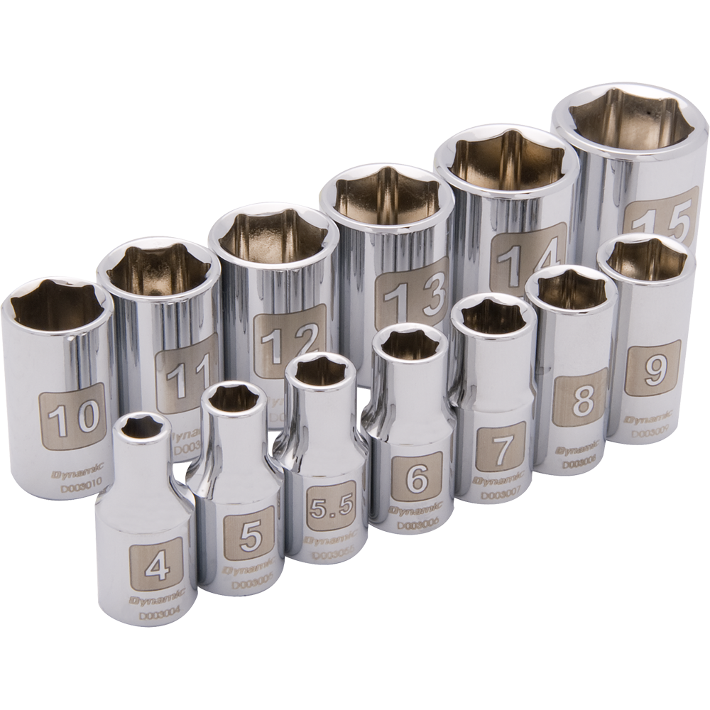
Six Point Sockets (khẩu vặn 6 cạnh)

Slide 26
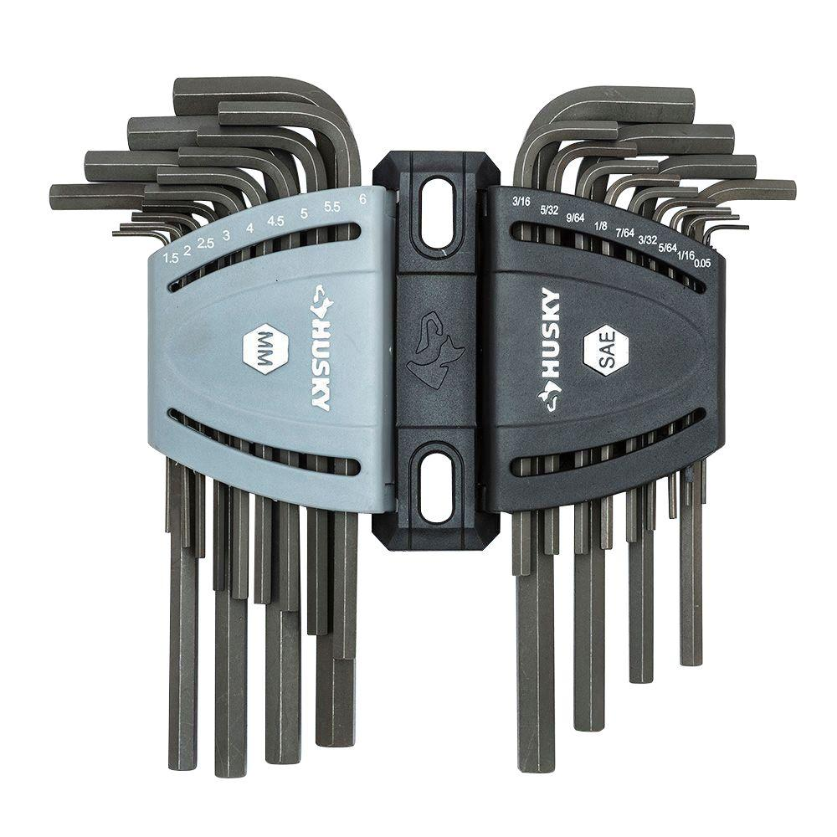
Hex Wrenches (bộ lục)

Slide 27
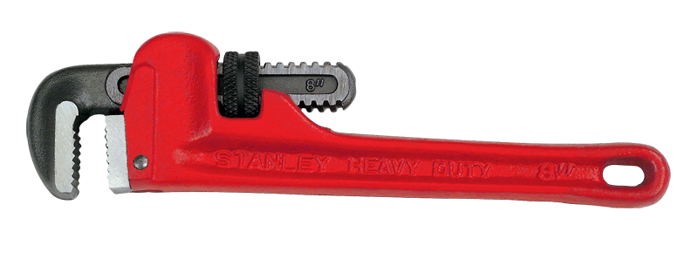
Pipe Wrenches (Kìm Nước)

Slide 28
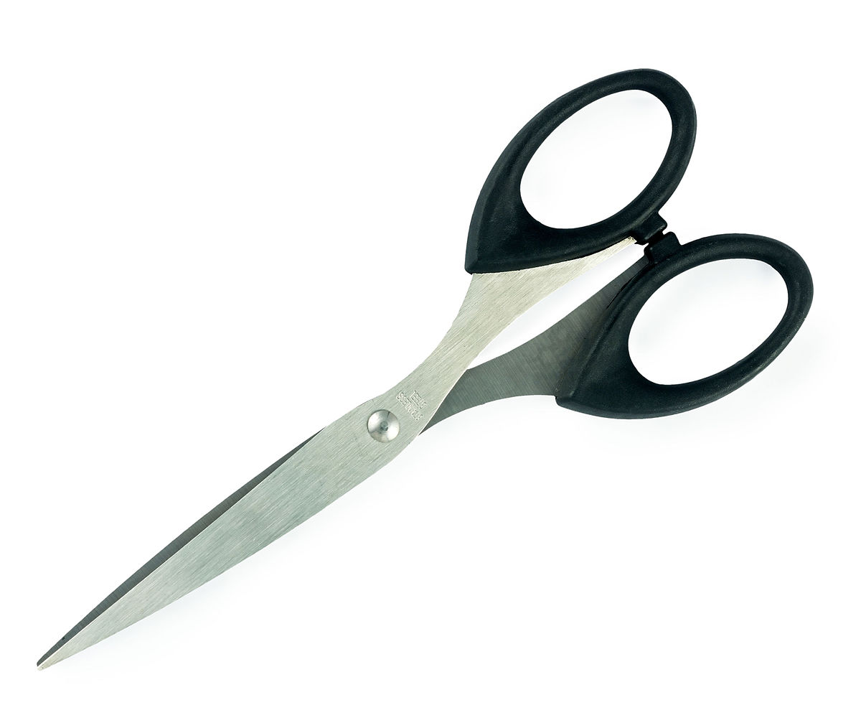
SCISSORS

Slide 29
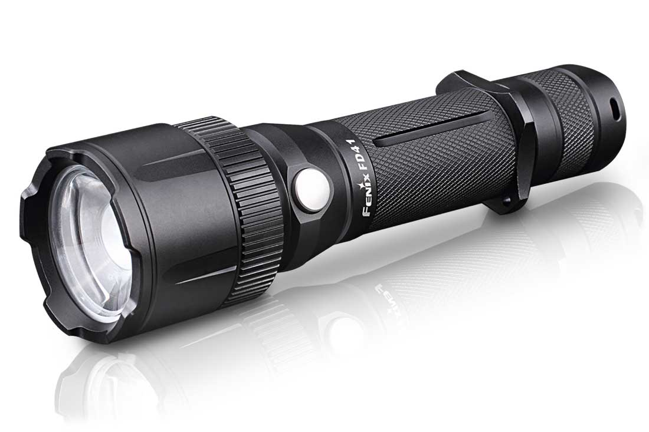
FLASHLIGHT

Slide 30
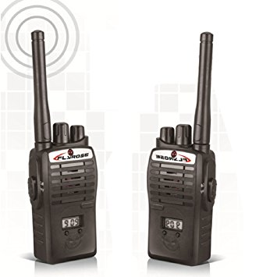
Interphone

Slide 31
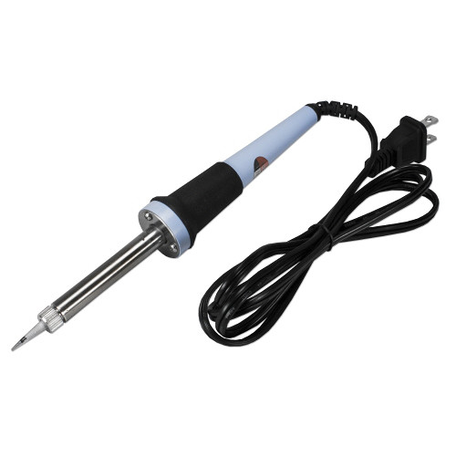
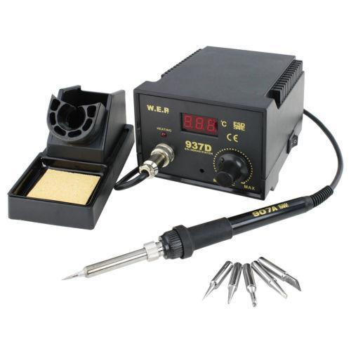
soldering iron/soldering station

Slide 32
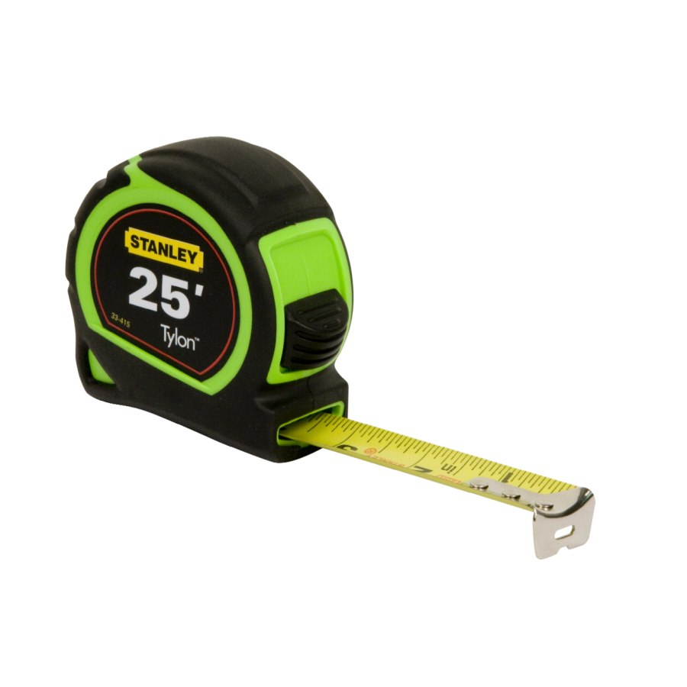

Tape Rulers/Self-lock tape Measures

Slide 33
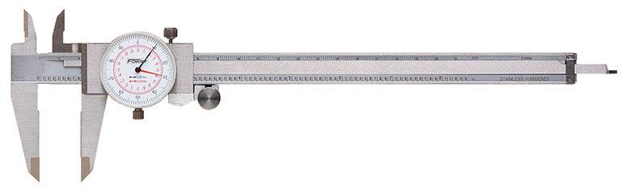
Dial Caliper

Slide 34
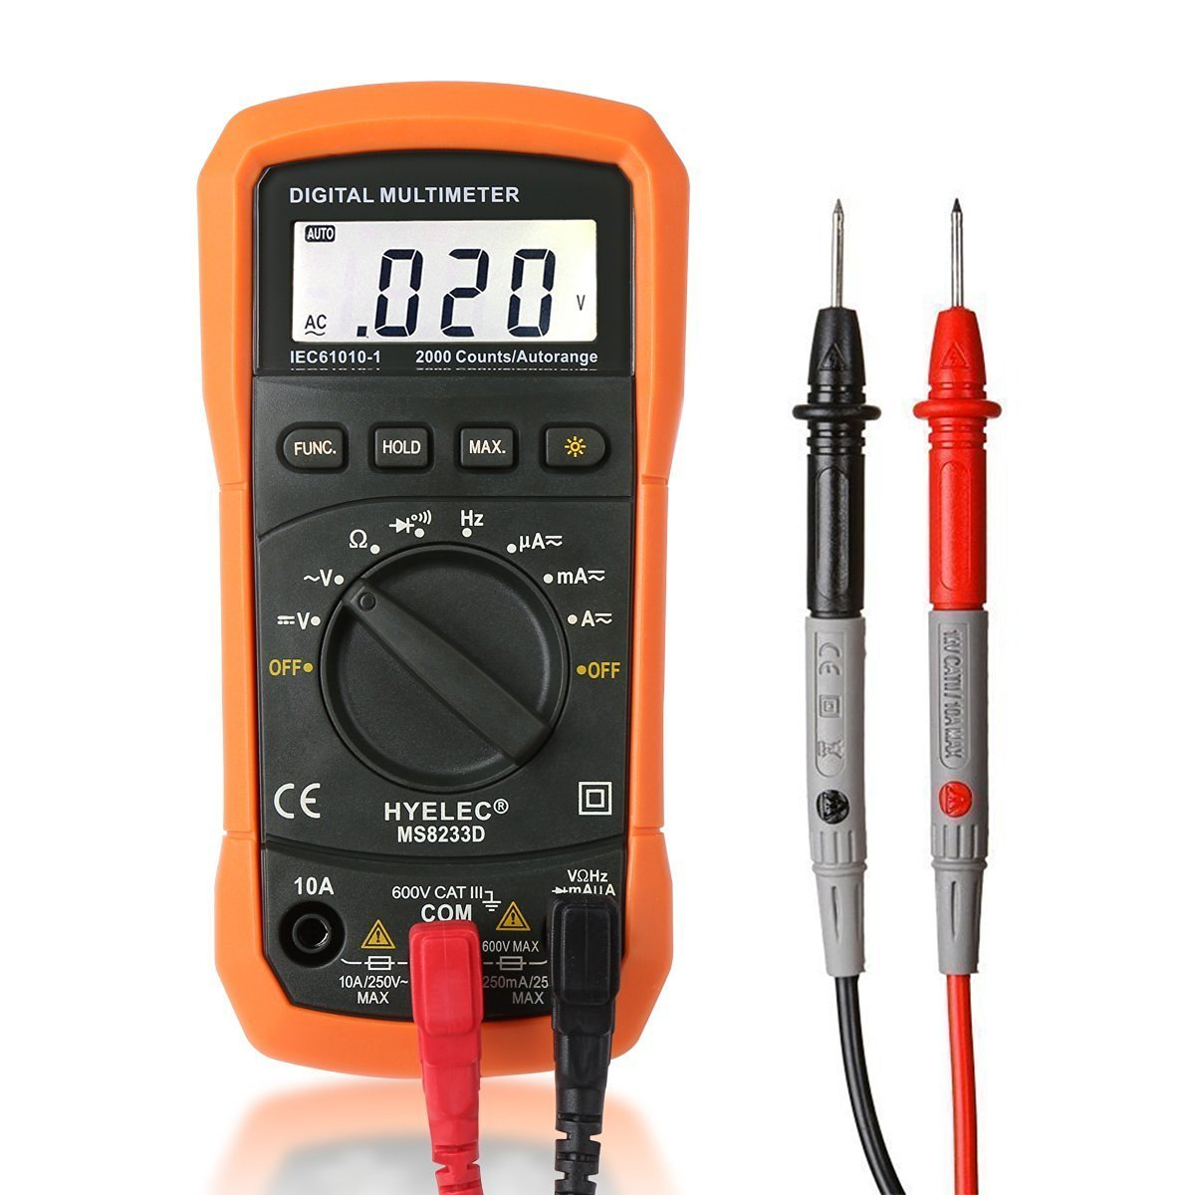
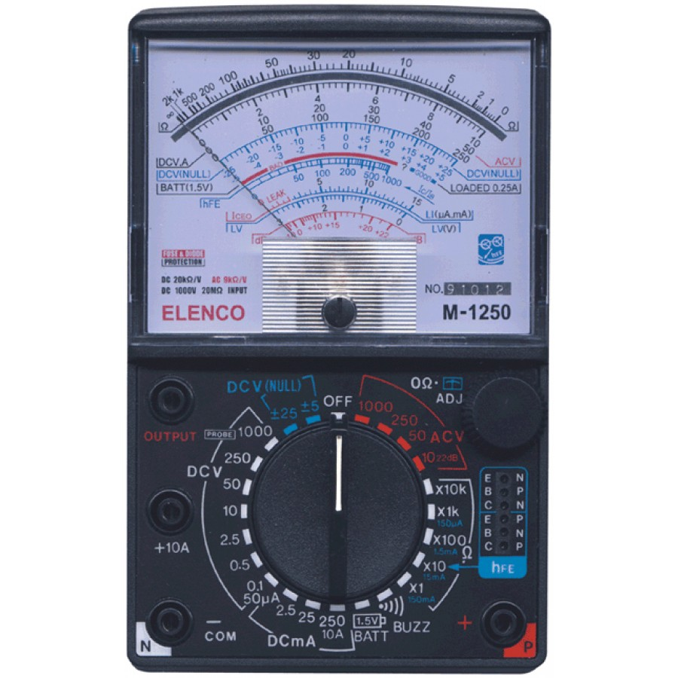
Analog Multimeter/Digital Multimeter

Slide 35

Utility Knife

Slide 36


Scraper Knife

Slide 37

metal saw

Slide 38

chainsaw

Slide 39


Chisels (Cái Đục)

Slide 40


File

Slide 41


tweezers

Slide 42

nail clippers

Slide 43

Hammer

Slide 44

Rubber Hammer

Slide 45

Metal Nails

Slide 46

Rivet Gun

Slide 47

Rivets (Đin tán)

Slide 48

Safety Pin

Slide 49

ladder

Slide 50

Rope

Slide 51


Sandpaper

Slide 52

Tape

Slide 53

Soldering wire

